Slide 1
OCS INFORMATIONAL BRIEF
Captain Chad Harper
Chad.harper@marines.usmc.mil
Cell: 917-346-5469
Office: 212-867-6926
Notes:
Freshman: 2, 6-week course (one after freshman year, one after junior year)
Sophomores: 2, 6-week courses (one after sophomore year, one after junior year)
Juniors: 10 wk course
Seniors: OCC

Slide 2
Annual Training Cycles
FALL OCC-3XX
Charlie Company |  |  | Delta Company
WINTER OCC-3XX
 | Charlie Company |  |  | Delta Company
 | SUMMER OCC-3XX/PLC-C
Alpha Company |  |  |  | Charlie Company |  |  | Delta Company
Average of 250 candidates per company
Average of 250 candidates per company
Average of 264 candidates per company
SUMMER PLC-Jrs/Srs
India Company 1st Inc |  |  | Lima Company 1st Inc |  |  | India Company 2nd Inc |  |  | Lima Company 2nd Inc
Average of 132 candidates in each India Company
Average of 300 candidates in each Lima Company
4
Notes:
Presenter
2020-04-14 17:13:27
--------------------------------------------
OCC: Officer Candidates Course. Fall and Winter provide (2) Companies of OCC candidates of approximately 500 candidates total with 1-2 female platoons. Summer OCC ships (3) companies of OCC and PLC-C (Platoon Leaders Course-Combined) of approximately 800 candidates. OCC, MECEP, ECP and PLC-C partake in the ten-week program of instruction (POI). OCC and PLC-C companies are labeled Alpha, Charlie and Delta. OCC, ECP, and PLC-Law candidates have graduated college and will commission directly following the OCC POI.
PLC Jr: Platoon Leaders Course-Juniors, reports twice during the summer months (1st Increment and 2nd Increment.) for the six-week Junior Program of Instruction. This POI closely mirrors the first five weeks of the OCC POI. India Company is the PLC-Jr company, and consists between132 - 264 candidates. Following completion of the PLC-Jr POI, candidates are then eligible to report back the following summer for PLC-Seniors. PLC Jr’s are typically recent freshman or sophomore’s in college. Currently, females only report for PLC-Jrs during 1st increment.
PLC Sr: Platoon Leaders Course-Seniors, reports twice during the summer months (1st Increment and 2nd Increment.) for the six-week Senior POI. This POI closely mirrors the second five weeks of the OCC POI. Lima Company is the PLC-Sr company, and consists of approximately 300-330 candidates. Following completion of the PLC-Sr POI, candidates return to college and upon graduation from college, they commission as Second Lieutenants. PLC-Sr’s are typically juniors in college who partook in the PLC-Jr POI or are executing the Naval Reserve Officer Training Corps (NROTC) at their college or university. Currently, females only report for PLC-Srs during 2nd increment. Summer 2019 Projection:
1,723 officer candidates are expected to ship to OCS during the Summer 2019 training cycle 1st Increment – 2 x PLC Companies
Co I, 2 Plts (66 M / 66 F) ➔ PLC-Jrs Co L, 5 Plts (303 M) ➔ PLC-Srs
3 x OCC-231 Companies (660 M / 132 F) Co A, 4 Plts
Co C, 4 Plts (1 Female Plt) Co D, 4 Plts (1 Female Plt)
2nd Increment – 2 x PLC Companies Co I, 2 Plts (132) ➔ PLC-Jrs
Co L, 6 Plts (396 M /100 F) ➔ PLC-Srs

Slide 3
Dates
ANTICIPATED COURSE DATES
EVENT | PLC-1st Inc | OCC-234 | PLC-2nd Inc
CHECK-IN | 23-May | 9-Jun | 27-Jun
ROM START | 24-May | 10-Jun | 28-Jun
ROM END | 6-Jun | 23-Jun | 11-Jul
IP START | 7-Jun | 24-Jun | 12-Jul
IP END | 11-Jun | 29-Jun | 16-Jul
TD START | 12-Jun | 30-Jun | 17-Jul
GRAD | 10/11 Jul | 15-Aug | 14/15 Aug

Slide 4
Mission
To educate and train officer candidates in Marine Corps knowledge and skills within a controlled and challenging environment in order to evaluate and screen individuals for the leadership, moral, mental, and physical qualities required for commissioning as a Marine Corps officer.

Slide 5
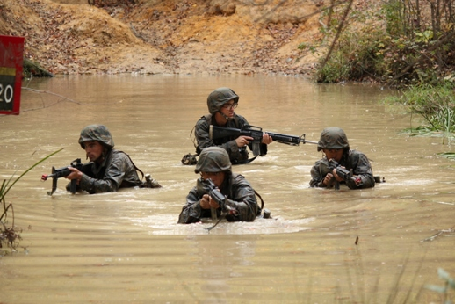
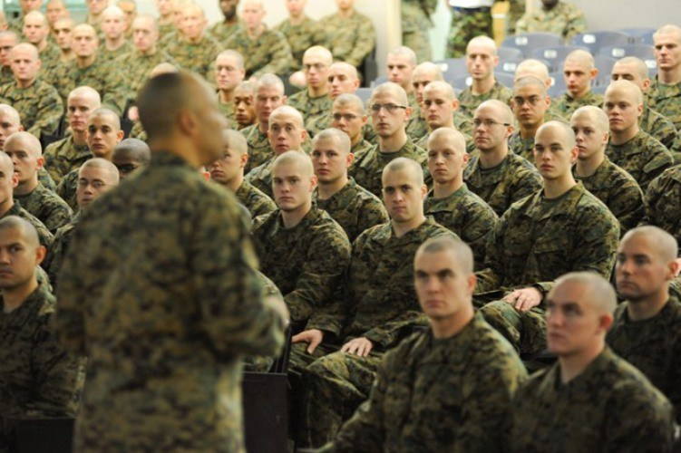
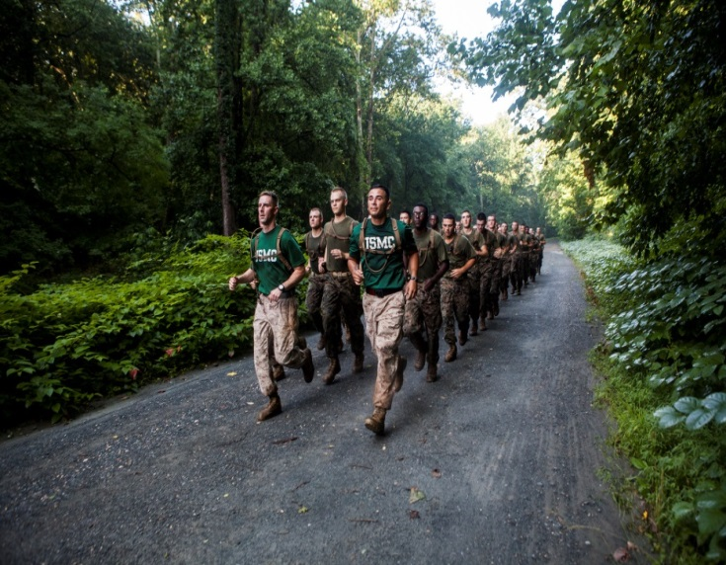
Program Of Instruction
Three evaluation categories
Leadership
Small Unit Leadership Evaluation
Command, Staff, and Peer Evaluations
Academics
Classroom instruction
Written exams and practical application
Physical Fitness
Endurance and strength training
25%
50%
Academics
Leadership
25%
Physical
Fitness

Slide 6
Five Marine Attributes
Exemplary Character
The individual candidate has a clear understanding that being a Marine brings a “special trust and confidence,” and the highest expectations of the American people. The individual candidate is devoted to the Corps values of honor, courage, and commitment, and possess a moral compass that unerringly points to “do the right thing” as an ethical warrior.
Physically and Mentally Tough
The individual candidate is imbued with a warrior spirit and able to thrive in a complex and chaotic environment; able to persevere despite the obstacles to mission accomplishment. The individual candidate possesses the self-discipline and will to push past personal preference and preconceived limits.
Warfighter
The individual candidate is grounded in basic infantry skills, characterized by sound judgment and aggressiveness in execution. Educated in the fundamentals of basic infantry tactics. Maintains an offensive mindset throughout; proactive not reactive.
Decide/Act/Communicate
The individual candidate can think critically and arrive at an acceptable decision based on sound tactical thinking within Commander's intent. Communicates effectively orally and in writing in tactical and administrative situations with an emphasis on issuing clear, meaningful orders and guidance. Has a bias for action; seizes the initiative and acts with boldness and determination on available information.
Leadership
The individual candidate embraces the "exceptional and unremitting “responsibility to one's fellow Marines and their families. Inspires and instills confidence in other candidates during times of adversity; sets the example in all things and at all times. Adheres to, and enforces standards regardless of time of day, location, or duty status, and treats all Marines and Sailors with dignity and respect.
5
Notes:
Presenter
2020-04-14 17:13:28
--------------------------------------------
OCS’s evaluation standard is twofold: 1) an objective performance-based grading determined by a candidate’s overall grade point average at the end of either the six- or ten-week training program and 2) the staff’s subjective evaluation of each candidate’s character and leadership potential. This dual evaluation process enables a complete evaluation of a candidate’s leadership, academic and physical performance to determine if a candidate has the martial spirit, proper mindset, mental agility, physical fitness and leadership potential required to graduate and receive a commission in the Marine Corps.
The following five Marine attributes, while not all explicitly Marine Corps leadership traits or principles, will assist the OCS staff in the evaluation of the candidate’s character and leadership potential. It is incumbent on the OCS staff to teach these five attributes so that the candidates can understand the tenets and be imbued with them, which will enable the candidates to demonstrate their leadership potential and succeed during their training and evaluation period at OCS. Additionally, these attributes are some of the key elements upon which the staff should focus in assessing the overall leadership and character attributes of a candidate and that the staff should address during candidate performance boards. Character of the Candidate
A Marine Corps Officer…
Dedicated to serve and protect The Nation and The U.S. Marine Corps Lives by Marine Corps values
Honor, Courage, Commitment “You Joined Us”
Accepts the challenge of leading and serving Marines Elite Warriors

Slide 7
Training Phases (10 weeks)
Phase I: In-Processing – 4 days
Medical screening, administrative processing
Phase II: Transition – weeks 1-2 (previously 1-3)
Create a disciplined environment
Introduction to Marine Corps culture
Phase III: Adaptation – weeks 3-5 (previously 4-5)
Increase responsibility on the billet holder
Emphasis on leading one’s peers
Phase IV: Decision Making and Execution – weeks 6-9
Practical knowledge of basic tactics with exhibited leadership skills
Major leadership events: Leadership Reaction Course (LRC) and Small Unit Leadership Exercise (SULE)
Phase V: Mentoring and Out-Processing – week 10
Mentoring, orienting, and preparing for steps after OCS
Graduation and Commissioning

Slide 8
OCS Course Map
IN-PROCESSING PHASE
TRANSITION PHASE
ADAPTATION PHASE
Admin In-processing Medical Screening Moment of Truth Initial PFT
Pick-up Brief Armory Issue Transition Training
Intro to Hike Program
Safe Weapons Handling Exam Buddy-Pair Fire & Movement Course Fire Team Assault Course
Exam 1 Intro to Hike LRC 1
Intro to Op Order Combat Course
IP 1-4
TD 1-4
TD 5-11
TD 12-18
DECISION MAKING AND EXECUTION PHASE
Exam 5 CFT Timed
PC Inspection
E-Course Timed
Exam 4
Night Land Nav Exam 6-Mile Hike
SULE 1
O-Course Test
Exam 3
Day Land Nav Exam Initial PRB
O-Course Timed
DOR Board Exam 2
4-Mile Hike LRC 2
Intermediate PFT
TD 40-46
TD 33-39
TD 26-32
TD 19-25
MENTORSHIP AND OUTPROCESSING PHASE
Exam 6
9.3-Mile Hike SULE 2
Final CFT Final PFT
Exam 7
E-Course Test NMMC Tour Final PRB
MoH Run / EGA Ceremony Montford Point Challenge TBS Breakfast
Company Field Meet
Motivational Run Family Day Graduation Ceremony
Commissioning Ceremony
TD 47-53
TD 54-58
TD 59-64
TD 65-66
Five Marine Attributes
Exemplary Character
Physically and Mentally Tough
Warfighter
Decide/Act/Communicate
Leadership
Graduation Requirements
80% or higher average in Leadership, Academic, and Physical Fitness Categories
Achieve 1st Class Final PFT Score
Complete SULE 2
OCS Outcome
All officer candidates are evaluated and screened for the leadership, moral, mental, and physical qualities required for commissioning as a Marine Corps officer.
7
Notes:
Presenter
2020-04-14 17:13:29
--------------------------------------------
OCS’s evaluation standard is twofold: 1) an objective performance-based grading determined by a candidate’s overall grade point average at the end of either the six- or ten-week training program and 2) the staff’s subjective evaluation of each candidate’s character and leadership potential. This dual evaluation process enables a complete evaluation of a candidate’s leadership, academic and physical performance to determine if a candidate has the martial spirit, proper mindset, mental agility, physical fitness and leadership potential required to graduate and receive a commission in the Marine Corps.
The following five tenets, while not all explicitly Marine Corps leadership traits or principles, will assist the OCS staff in the evaluation of the candidate’s character and leadership potential. It is incumbent on the OCS staff to teach these five tenets so that the candidates can understand the tenets and be imbued with them, which will enable the candidates to demonstrate their leadership potential and succeed during their training and evaluation period at OCS. Additionally, these traits are some of the key elements upon which the staff should focus in assessing the overall leadership and character attributes of a candidate and that the staff should address during candidate performance boards.

Slide 9
Program of Instruction
Three evaluation categories
Leadership
Small Unit Leadership Evaluations
Command, Staff, and Peer Evaluations
Academics
Classroom instruction
Written Exams and Practical Applications
Physical Fitness
Endurance and strength training
Tested Event LRC I
LRC II SULE I SULE II
Command Evaluation I Command Evaluation II Command Evaluation III Platoon Commander Inspection
Tested Event
Exam 1 (Weapons, Customs & Courtesies) Exam 2 (Ethics, Ethos, History, Field Skills) Exam 3 (Operation Order Intro & Development) Exam 4 (History, Land Navigation, & Uniforms)
Exam 5 (History, UCMJ, Law of War, & Squad Tactics) Exam 6 (History, Equal Opportunity, Substance Abuse) Exam 7 (History, Fundamentals of Leadership)
Day Land Navigation Night Land Navigation
Tested Event Intermediate PFT Final PFT
Final CFT Obstacle Course Endurance Course
6-Mile Conditioning March 9.3-Mile Conditioning March
8
8
Notes:
Presenter
2020-04-14 17:13:29
--------------------------------------------
OCS focuses on developing a warrior ethos through a layered approach: platform instruction and testing, Plt Cmdr and Sergeant Instructor group discussions, and reinforced through evaluated FEXs and SLEs. Additionally, the new basis for the POI, the 6Fs, reinforces the foundation through organization. However, the warrior ethos is inculcated in everything that we do in the Marine Corps from entry-level training, through sustaining the transformation in the opfor and follow-on PME schools.
OCS is succeeding at weaving character, ethical development, a fighter mindset, and fidelity, which leads to producing ethical warriors.

Slide 10
Juniors vs. Seniors (6 weeks)
JUNIORS: |  | SENIORS:
4 Mile Hike |  | 6 Mile Hike
6 Mile Hike |  | 9.3 Mile Hike
COMBAT FITNESS TEST |  | COMBAT FITNESS TEST
Command Evaluation I Jrs |  | Command Evaluation 1 Srs
Command Evaluation II Jrs |  | Command Evaluation 2 Srs
Day Land Navigation Performance Examination |  | Day Land Navigation Performance Examination
Exam I |  | Endurance Course Test
Exam II |  | Exam I
Exam III |  | Exam II Srs
Exam IV |  | Exam III
Final Physical Fitness Test |  | Exam IV Srs
Inventory Physical Fitness Test |  | LRC 2
Junior's Stamina Course Test |  | Night Land Navigation Performance Examination
LRC I |  | Obstacle Course Test
Obstacle Course Test |  | Platoon Commander's Uniform and Equipment Inspection
SULE I |  | Seniors Comp Exam
 |  | Small Unit Leadership Evaluation 2
Notes:
Not in any order

Slide 11
Screening and Evaluating Process
6 Types of Boards
Induction Board
Informal board (Must meet the minimum PFT score requirement of 220)
Initial Physical Fitness Test & Initial Height and Weight
Drop on Own Request Board
Beginning of week 4 and the right of every candidate per their Service Agreement
Medical
Not Physically Qualified recommendation given by OCS Medical staff
CO, OCS makes the final determination (Injury sustained, when in the POI, etc)
Inability to Evaluate
Candidate has been unable to train for an extended period of time
Performance
Performance Review Boards (Initial, Incidental, Final)
Driven by events, not week
Incidental
Can happen any time during the Program of Instruction
Egregious act or acts that warrant immediate dismissal from OCS
Process
Very detailed and deliberate approach
Platoon, Company, Coordinator of Student Activities and MCRC Liaison, ending with a formal command-level screening by the CO, OCS
9
Notes:
Presenter
2020-04-14 17:13:30
--------------------------------------------
Types of Boards:
Induction Board – Occurs the day prior to TD-1. Candidates that have failed to achieve an overall score of 220 or the minimums listed for each event on the iPFT or make-up iPFT will be boarded by the CO, OCS where a decision will be made based on the advice given from the OCS PT Advisor, that candidates specific area of deficiency, and an understanding of the POI / training environment. Those candidates found outside of their respective HT/WT for their age will also be boarded regardless of PFT score. Any candidate wishes to iDOR (follow DOR guidance), they will also be seen by the CO, OCS prior to induction.
Drop on Own Request: Although candidates have signed a four week training contract, they may request to DOR at any time. Additionally, MECEP and ECP candidates’ obligated time is based on their respective selection board MARADMIN. It is the intent of the CO, OCS to retain all DOR candidates for their entire obligation prior to allowing them to formally DOR to him. When this is not possible, the CO, OCS will see the candidate as soon as possible via a DOR board. If at any point in training, a candidate indicates that they are a threat to others or themselves, the Company Commander will recommend the candidate immediately be removed from the training company for medical evaluation and/or disenrollment.
**Service Agreement NAVMC 10461.
*Prior to formally DOR’ing: PC chit / interview, Company CO/XO talk and coordinate with CSA, CSA/MCRC interview, return to training until DOR Board. (Have the ability to rescind at any time, with the initial DOR not being held against them)
Medical – Medical boards are formal boards during in-processing that discuss, in detail, the candidates present issue/s. A decision is made by the CO, OCS based on an understanding of the training environment and a competent medical authorities recommendation. During the training cycle, the board is informal. The CSA is told by OCS Medical about a candidate’s condition, information is gathered and then briefed to the CO, OCS. If found NPQ, then the word is relayed to the training company and candidate for disenrollment. Every candidate will always speak with the CSA and MCRC prior to departing OCS. ITE - If a candidate has spent five consecutive or ten cumulative days in a light/limited duty status, the training company may request an inability to evaluate decision to disenroll the candidate .
**This is a rule of thumb and should be a discussion between the company staff and the CSA. The guiding factor will be the extent of significant training the candidate has missed.
Performance Review Boards –
PRB1 – FTA Board (well documented. These candidates can not perform individual tasks or pose a risk to themselves or others based on their current ability to operate in the environment.) PRB2 – Late breaking FTA, triggered by category (Academics / Leadership), or possible 5-tenets issue (well documented).
PRB3 – Categorical board and possible 5-tenets (strong case that is well documented over the course of 10 weeks)
Incidental - An incidental board may be convened at any time during the program. The training company will notify CSA of the potential incident and conduct a company level incidental board within 12 hours of learning of an incident. Incidental boards may remain at the company level to stress a correction for wrong doing, a command level incidental board should be used ONLY when a candidate has done something so egregious that the company staff feels the infraction rates expedited disenrollment and departure from Brown Field. (Cheating, lying, stealing, fighting, etc.) Board Process:
Prior to formal command-level board-
•Company Level Board is Conducted: PltSgt, PltCmdr, Co 1stSgt, Co XO, and Co Cmdr review the candidate’s performance. The Co Cmdr determines if the candidate is to be retained on Company Probation or recommended to the CO, OCS for Command Level Probation or Disenrollment.
•MCRCInterview: Candidates to be boarded at the command level conduct interview with MCRC Liaison. During this interview the candidate will have the opportunity to call their OSO. The MCRC Liaison provides another viewpoint into the candidate’s performance, preparation, and background to the CO, OCS during the board.
•CSA Review: Determines if the OCS evaluation standard was properly applied through a review of all documents within the Candidate Record Book (CRB). On command-level board-
Company Staff: PltSgt, PltCmdr, Co 1stSgt, Co Cmdr brief a summary of the candidate’s daily performance as well as the candidate’s conduct on the Company Level Board. The staff will also provide recommendations to the CO, OCS for what the candidate can do to improve their deficiencies.
•MCRC provides insight into the candidate’s explanation of their performance as well as any pertinent information from the candidate’s OSO.
•CSA ensures that the candidate was evaluated appropriately against the standard based on the review of all documents within the Candidate Record Book (CRB).
•SgtMaj serves as senior enlisted advisor.
•The Commanding Officer conducts the board by interviewing the candidate and makes the final determination on whether to retain the candidate on Command Probation or disenrollment.

Slide 12
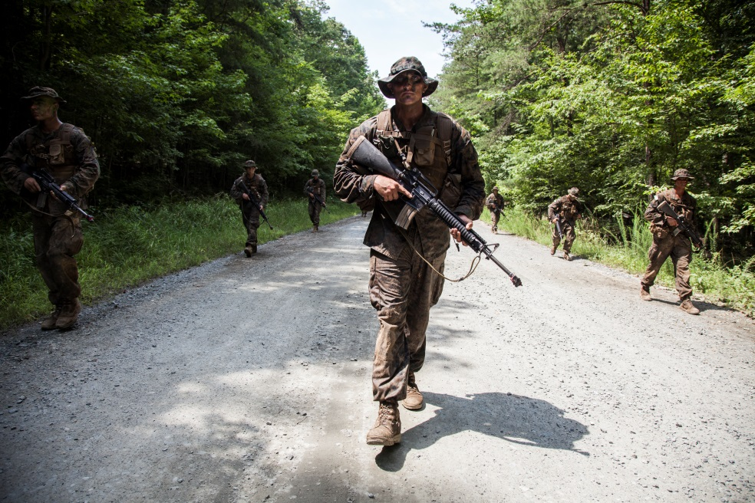
Leadership Evaluation
The Marine Corps seeks leadership potential
Autobiography/Achievements
Commander’s interview
Leadership essay
Impromptu speech
Leadership billets
Attributes
Leading peers
Command presence
Decision-making
Communication skills
Judgment and bearing
Effectiveness under arduous military conditions

Slide 13
Physical Fitness Evaluation
PT Schedule
All PT is conducted outdoors:
Candidates must arrive prepared and conditioned
Candidates on average cover 51 miles per week
Candidates typically burn 3200 calories per day
Circuit based PT - (Calisthenics) includes Upper Body Development, Abs/Push/Pull/Press, the Muscular Endurance Course and Fartlek Run Exercises
Huge amount of running – between 3-5 miles
Obstacle Course – mastery of techniques is essential
Endurance Course – culminating PT event
Hike Program - 3, 4, 6, 9 Mile Hikes with weight ranging from 45-51 lbs
Graduation requirements – PFT, CFT (1st class - 235), E-Course & 9.3 Mile Hike
Typical Average PFT Score Increase
- 3 mile run drop 1-2 mins / crunches increase 12-20 / pull ups increase 1-2
- Candidates typically improve PFT score by 12-20 points

Slide 14
OCS Mileage Data
Mileage a day = 9.00
Mileage a week = 59.32
Highest mileage day = 25.34
Highest mileage week = 76.02
Lowest mileage day = 1.75
Lowest mileage week = 36.31
Calories burned per day = 2715.80
Highest calories burned per day = 3824.50
Based off of averages from OCC-225 and OCC-226 (summer and fall 2017)
Utilized newest version of VivoFit Activity Tracker

Slide 15
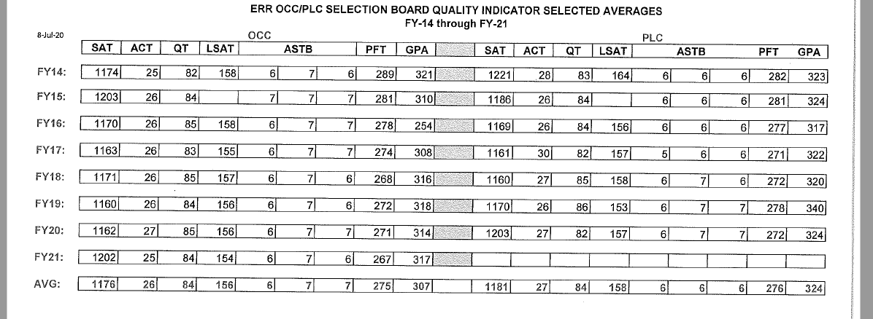
Average Indicators for Selected Candidates

Slide 16
End of Course Critiques/ Candidate Comments
“I wish I had more time in the program with the OSO to improve on areas of concern prior to the course.”
“A mini OCS would have been helpful.”
“I had never hiked under weight before, which showed during all the hikes. I also struggled with core strength.”
“I had a higher PFT score so my OSO believed I wouldn’t have any problems here. So I came unprepared for the intensity of the PT sessions and hikes. This was all because PFT scores are the only fitness aspect required to come.”
“General USMC knowledge was lacking.”
“Was not fully ready for level of PT or the general attitude of the instructors”
“This candidate didn’t run as much as he should have. This candidate focused more on strength training.”

Slide 17
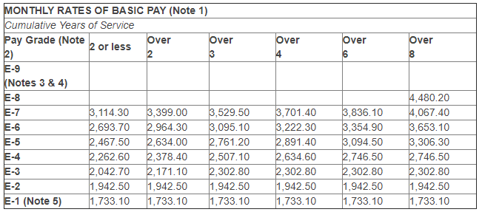
Pay at OCS and Tuition Assistance
Freshman – Sophomores: About $3,701 for 6 weeks
Juniors – Seniors: About $6,155 for 10 weeks (seniors immediately commission as 2ndLts after OCS graduation)
Tuition Assistance
MCTAP
MCFAP
Change of PEBD to date of commissioning and adds an additional active duty year to your 4 year contract in exchange for:
$5,200 per academic year. The max a student may receive is $15,600 over a period of 3 consecutive years
Adds an additional 6 months of active duty to your 4 year contract in exchange for:
$1,575 per semester for two semesters (excludes summer) per academic year for up to 3 academic years.

Slide 18
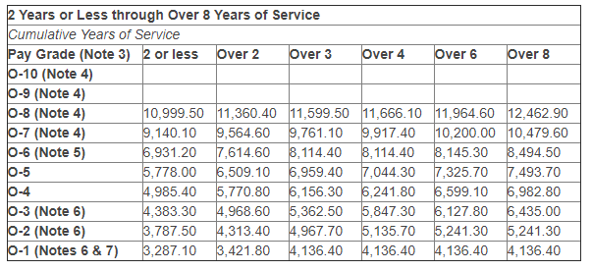
Pay Upon Commissioning
Basic Pay
(taxable)
+
Basic Allowance for Housing (BAH) (non-taxable) based on housing
+
Basic Allowance for Subsistence (BAS) (non-taxable)
$256.68
First Duty Station Camp Pendleton Example
Basic: $3,287.10
BAH: $2,187.00
BAS: $256.68
Total: $5,730.78
First Duty Station Camp Pendleton Example
Basic: $4,313.40
BAH: $2,523.00
BAS: $256.68
Total: $7,093.08
2 Year Mark

Slide 19
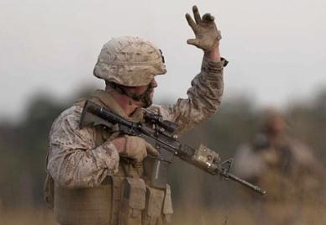
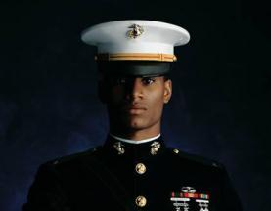
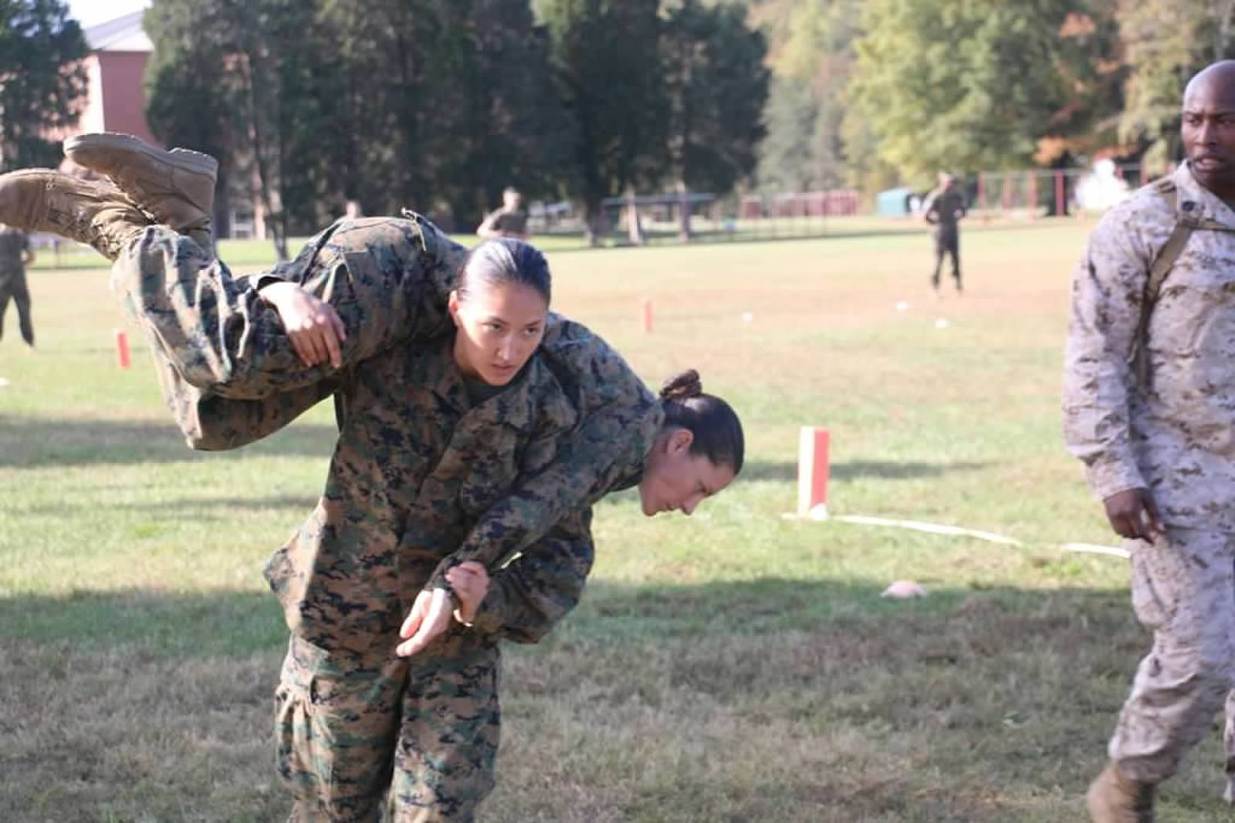
The U.S. Marine Corps Officer
A Man or Woman of Exemplary Character
Devoted to leading Marines 24/7
Able to Decide, Communicate, Act and Assess in the Fog of War
A Warfighter who embraces the Warrior Ethos
Mentally Strong and Physically Tough

Slide 20
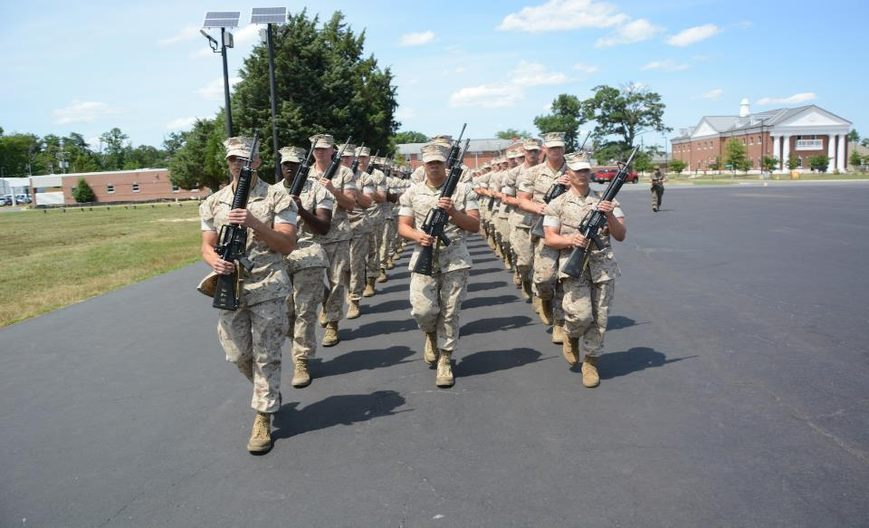
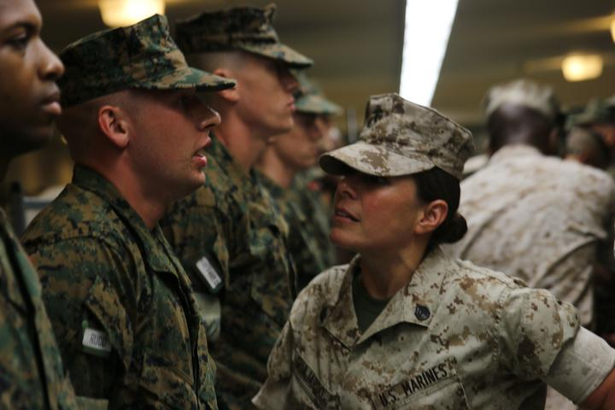
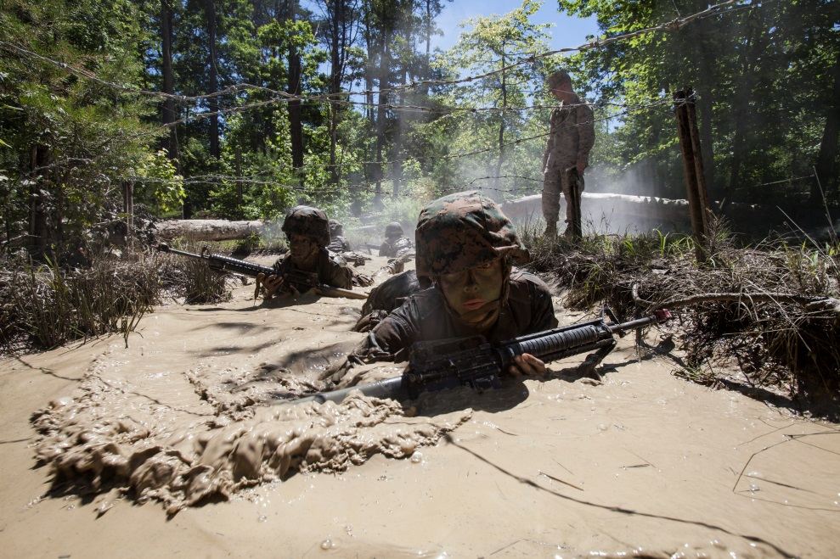
Questions?

